Slide 1

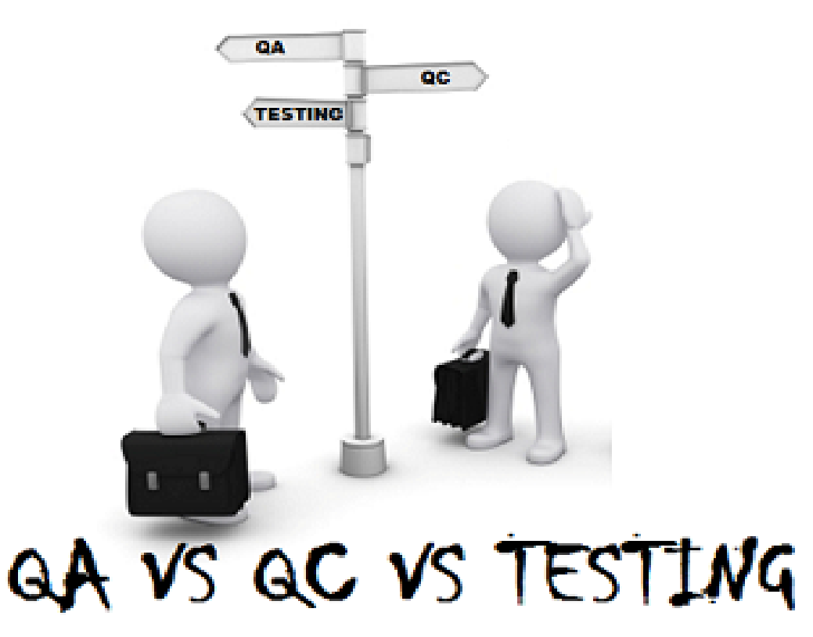
Mithilesh Singh

Slide 2
Quality Assurance (QA) Quality + Assurance Software Quality is defined as the product meets or exceeds the requirements and needs of customers and it is free from defects. Assurance gives a guarantee that the product will work without any glitches as per the requirements or expectations. Quality Assurance (QA) Testing might help in detecting defects, but not in avoiding them. A defect once fixed cannot ensure that it won’t occur again, even if the root cause is found. The process or the system that allowed that defect to occur is what needs to be re-engineered, and this is what we call quality assurance.
Quality assurance has a defined cycle called the Deming cycle or PDCA cycle.

Slide 3
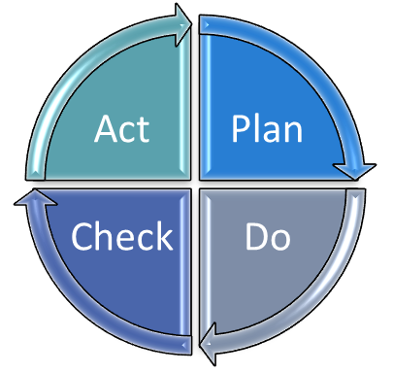
What is PDCA Cycle?
The PDCA cycle consists of four steps namely Plan, Do, Check, and Act. It is one of the key concepts of quality. Note: This is known as Deming process because it is developed by Dr. William Edwards Deming in the 1950s as a learning or improvement process.
Plan : we define the objective, strategy, and supporting methods in plan.
Do : Here we implement the plan.
Check : we make a checklist to record what went well and what did not work
Act : we take action on what is not working as planned

Slide 4
Quality Assurance (QA)
QA aims to prevent the defect
It is a method to manage the quality- Verification
It’s a Preventive technique
It is the procedure to create the deliverables
It is performed before Quality Control
It is a Low-Level Activity, it can identify an error and mistakes which QC cannot
Its main motive is to prevent defects in the system. It is a less time-consuming activity
QA ensures that everything is executed in the right way, and that is why it falls under verification activity
QA involves in full software development life cycle
It does not involve executing the program
* QA is also known as Verification or static testing ** Deliverables mean all the documents which we handover to the client as a proof of testing and development process. It gives clear understanding like what we have done.

Slide 5
What are the QA engineer responsibilities?
Analyze and clarification of requirements with a customer or a business analyst
Plan the process of testing
Write test cases (test scripts)
Identify problem areas, add them to a tracking system
Track the life cycle of errors
Analyze testing
Optimize the testing process
Analyze the team work processes
Improve processes
Maintain the test documentation

Slide 6
What are all Different QA roles?
There are four main QA roles: Test Analyst, Test Designer,
Test Executor, and
Test Manager.
Test Analyst is engaged in static testing of requirements and checks them for completeness and consistency.
Test Designer creates a set of tests based on requirements and plans configurations that are necessary for testing.
Test Executor performs pre-planned tests, describes and documents the found errors, and steps for reproducing (or fixing) them.
Test Manager plans and monitors work related to testing such as keeping to deadlines, following a schedule, controlling requirements to tests, setting tasks for team members, and communicating with stakeholders.

Slide 7
Quality Control(QC) Quality + Control Control: Control is to verify errors in order to maintain standards by testing the output against the specification.
Quality Control(QC): involves in product-oriented activities. It executes the program or code to identify the defects in the Software Application.

Slide 8
Quality Control (QC)
It is a procedure that focuses on fulfilling the quality requested.
QC aims to identify and fix defects
It is a method to verify the quality-Validation
It’s a Corrective technique
It is the procedure to verify that deliverables
It is performed only after QA activity is done
It is a High-Level Activity, it can identify an error that QA cannot
QC ensures that whatever we have done is as per the requirement, and that is why it falls under validation activity
QC involves in full software testing life cycle
QC is also known as Validation or dynamic testing

Slide 9
Note: 1. Now a days QE is getting used more than QC. QE stands for Quality Engineer. 2. QE takes care of manual testing of product along with some coding activity. 3. Testing is a subset of Quality Control. 4. Quality control is a set of “activities” that need to be performed in order to detect problems during production and before the product goes live. These activities ensure that final deliverable meets the specifications and quality standards set by the organization. QC often includes peer reviews, “testing”, code reviews etc. 5. QA and QC both are the part of Quality Management. 6. Everyone who is involved in the end to end development process, including analysts, developers, testers, managers etc., is an important player in assuring quality. In fact, QA might not involve testing at all 7. Statistical Tools & Techniques can be applied in both QA and QC .
When it is applied to processes they are called Statistical Process Control(SPC) and it is part of QA. When it is applied to finished products they are called as Statistical Quality Control(SQC) and comes under QC.

Slide 10
Note:
Quality assurance is a set of processes that help “avoid” defects and assure quality. While Quality Control is a set of activities that help detect defects and quality issues before the products reach the hands of end customers. Testing is one of the ways of detecting those defects. If you are interested to know more about testing then visit this link: 1. https://github.com/mithilesh777/softwaretesting/blob/master/Manual%20Testing.pdf
2. https://github.com/mithilesh777/softwaretesting/blob/master/ManualTesting_RealTimeExample.pdf

Slide 11

Mithilesh Singh

